Slide 2
SURVIVAL RULES OF 3
THE HUMAN BODY CAN’T SURVIVE 3 MINUTES WITHOUT AIR, 3 DAYS WITHOUT WATER, AND 3 WEEKS WITHOUT FOOD.

Slide 5
What is really significant? What will really stand the test of time? What will have meaning when other things cease to do so? Paul refers to three of his favorite themes--faith, hope and love. All of these are significant components of the Christian life.

Slide 6
Living by Faith
What is faith?
It is the confident assurance that what we hope for is going to happen. It is the evidence of things we cannot yet see
Heb. 11:1 NLT

Slide 7
Faith is key because right belief leads to right relationship. Faith is the means by which we are joined to Christ. We must accept Him by faith. We live and follow His path for life by faith.
The life I live in the body, I live by faith in the Son of God, who loved me and gave himself for me Gal 2:20b

Slide 8
The scripture says “without faith it is impossible to please Him” (Hebrews 11:6).
It is faith, which allows us to overcome the weakness of our own flesh to pursue the holiness and righteousness of God.

Slide 9
Living by Faith
Our faith will be tested though now for a little while you may have had to suffer grief in all kinds of trials. These have come so that the proven genuineness of your faith - of greater worth than gold, which perishes even though refined by fire—may result in praise, glory and honour when Jesus Christ is revealed.
1 Peter 1:6-7

Slide 11
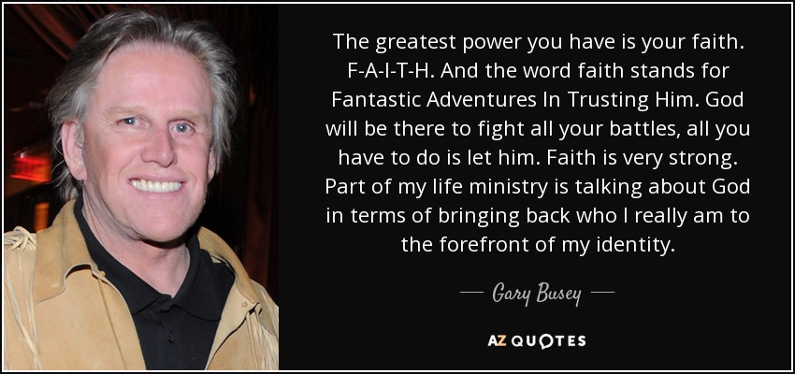

Slide 12
Living In Hope
To live without hope is to cease to live
Fyodor Dostoevsky

Slide 13
Hope, for Paul, meant the ultimate blessings that await us in Heaven. Hope is the end game toward which faith points us. Hope keeps us going even in the darkest hours. It is the internal reality of a future that is completely real to one who has experienced Jesus Christ in his or her life. Hope drives us forward and keeps us from being too bogged down in the here and now.

Slide 14
Living In Hope
God is the source of real hope
May the God of hope fill you with all joy and peace as you trust in him, so that you may overflow with hope by the power of the Holy Spirit.
Rom 15:13

Slide 15
Living In Hope
Hope for the future
while we wait for the blessed hope – the glorious appearing of our great God and Saviour, Jesus Christ
Titus 2: 13

Slide 16
Living with Love
Love must be the priority
If I speak in the tongues of men and of angels, but have not love, I am only a resounding gong or a clanging cymbal. If I have the gift of prophecy and can fathom all mysteries and all knowledge, and if I have a faith that can move mountains, but have not love, I am nothing.

Slide 17
For Paul, love was not just an emotional feeling. It was an attitude of heart and mind that directed the actions and attitude of believers toward each other and the world around them. It was faith and hope acted out.
Of these three, Paul says that love is the greatest of the three. Why does Paul say this? It is because love completes and fulfills the practice of faith and the reality of hope.

Slide 18
Love is the demonstration that faith is active in our lives, because love was the hallmark of the life of Jesus. When we love we are letting our faith in Christ demonstrate His love flowing through us. Our hope is for a world without sin, anger, tears, and heartbreak. In other words we hope for a world dominated by love. When we love now, we demonstrate the reality of hope in our hearts.
It is important what and in whom we believe. It is critical to have a true hope for our future with Christ. But love undergirds and validates both faith and hope. We cannot speak meaningfully about faith and hope unless we practice love.

Slide 20
• FAITH makes all things possible
• HOPE makes all things bright
• LOVE makes all things easy

