Slide 2
God Is For Us!
Romans 8: 22-39
…If God be for us, who can be against us

Slide 3
1. He wants us to have hope
Romans 8:22-25

Slide 4
Romans 8:22-25 (NLT)
22 For we know that all creation has been groaning as in the pains of childbirth right up to the present time. 23 And we believers also groan, even though we have the Holy Spirit within us as a foretaste of future glory, for we long for our bodies to be released from sin and suffering. We, too, wait with eager

Slide 5
Romans 8:22-25 (NLT)
hope for the day when God will give us our full rights as his adopted children, including the new bodies he has promised us. 24 We were given this hope when we were saved. (If we already have something, we don’t need to hope[b] for it. 25 But if we look forward to something we don’t yet have, we must wait patiently and confidently.)

Slide 6
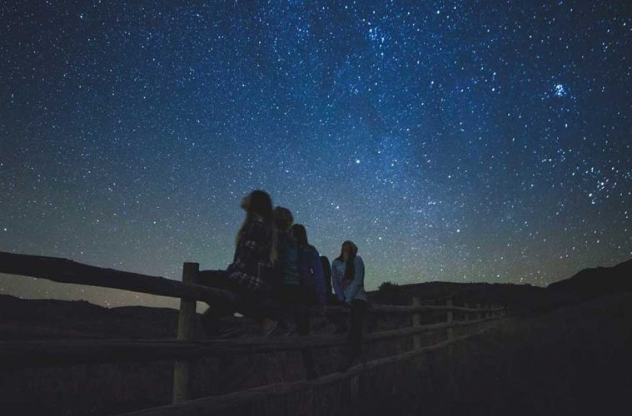
“Only in the darkness can you see the stars.”
-Martin Luther King Jr.-

Slide 7
2. He wants us to receive help
Romans 8:26

Slide 8
Romans 8:26 (NLT)
²⁶ And the Holy Spirit helps us in our weakness. For example, we don’t know what God wants us to pray for. But the Holy Spirit prays for us with groanings that cannot be expressed in words.
Even Jesus our Lord is currently praying for us.

Slide 9
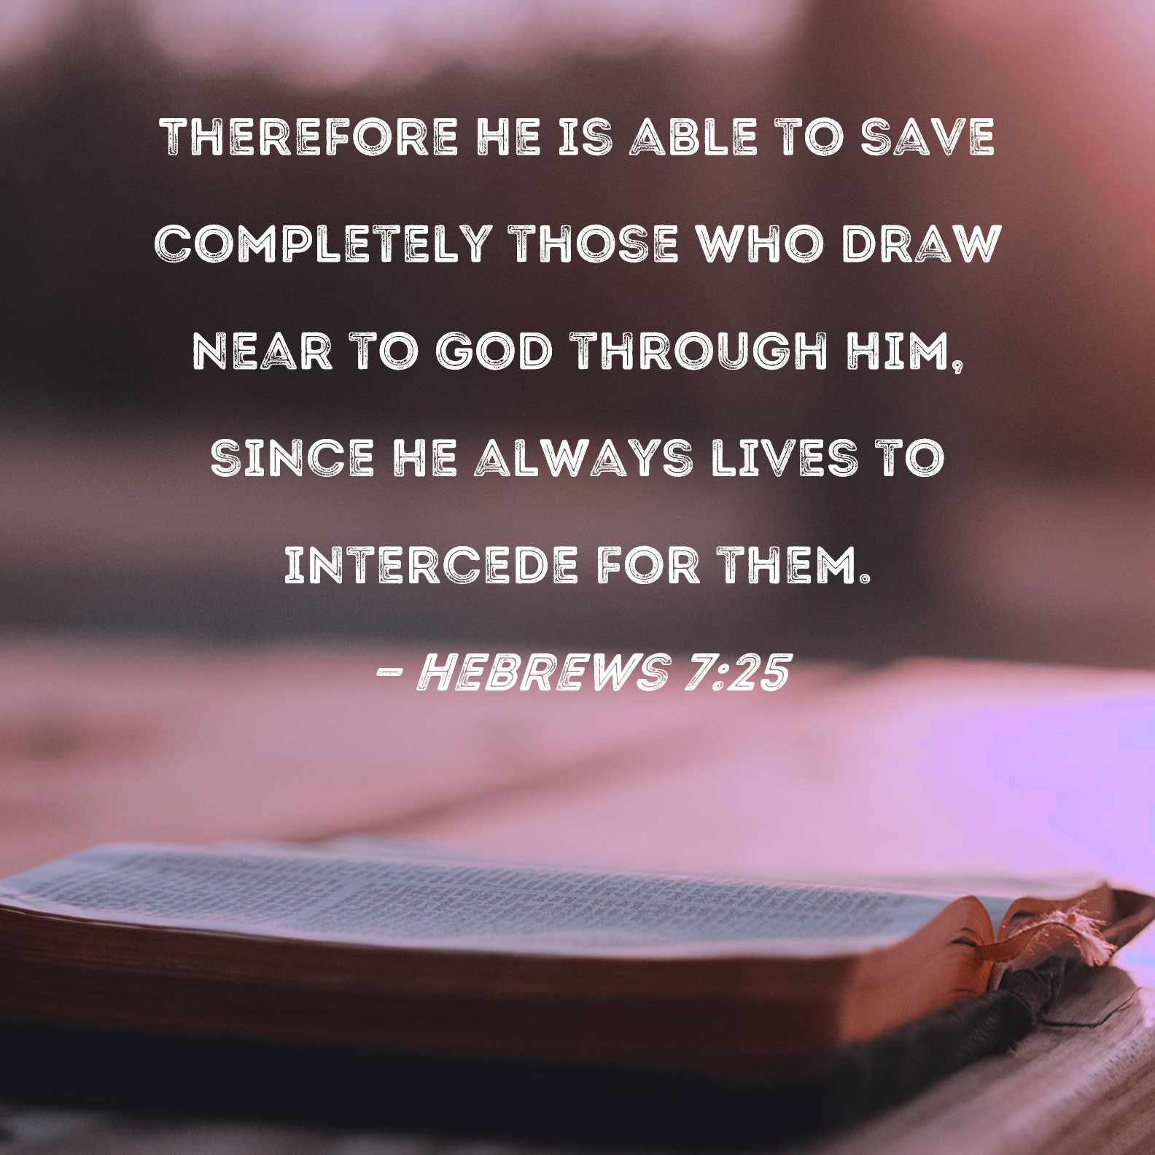

Slide 10
3. He wants us to be encouraged in our prayers
Romans 8:27

Slide 11
Romans 8:27 (NLT)
²⁷ And the Father who knows all hearts knows what the Spirit is saying, for the Spirit pleads for us believers in harmony with God’s own will.

Slide 13
4. He wants us to share the best
Romans 8:28-30

Slide 14
Romans 8:28-30 (NLT)
²⁸ And we know that God causes everything to work together for the good of those who love God and are called according to his purpose for them. ²⁹ For God knew his people in advance, and he chose them to become like his Son, so that his Son would be the firstborn among many brothers and sisters.

Slide 15
Romans 8:28-30 (NLT)
³⁰ And having chosen them, he called them to come to him. And having called them, he gave them right standing with himself. And having given them right standing, he gave them his glory.

Slide 17
5. He wants us to have all things.
Romans 8:31-34

Slide 18
Romans 8:31-34 (NLT)
³¹ What shall we say about such wonderful things as these? If God is for us, who can ever be against us? ³² Since he did not spare even his own Son but gave him up for us all, won’t he also give us everything else? ³³ Who dares accuse us whom God has chosen for his own?

Slide 19
Romans 8:31-34 (NLT)
No one—for God himself has given us right standing with himself. ³⁴ Who then will condemn us? No one—for Christ Jesus died for us and was raised to life for us, and he is sitting in the place of honor at God’s right hand, pleading for us.

Slide 20
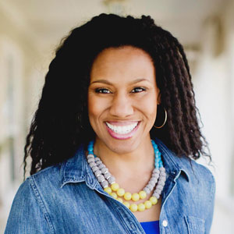
“We often don't realize that where God puts us is the very place we need to be to receive what He wants to give us.”
Priscilla Shirer

Slide 21
6. He wants us to be kept in His love
Romans 8:35-39

Slide 22
Romans 8:35-39 (NLT)
³⁵ Can anything ever separate us from Christ’s love? Does it mean he no longer loves us if we have trouble or calamity, or are persecuted, or hungry, or destitute, or in danger, or threatened with death? ³⁶ (As the Scriptures say, “For your sake we are killed every day; we are being slaughtered like sheep.”)

Slide 23
Romans 8:35-39 (NLT)
³⁷ No, despite all these things, overwhelming victory is ours through Christ, who loved us.
³⁸ And I am convinced that nothing can ever separate us from God’s love. Neither death nor life, neither angels nor demons,neither our fears for today nor our worries about tomorrow—

Slide 24
Romans 8:35-39 (NLT)
not even the powers of hell can separate us from God’s love. ³⁹ No power in the sky above or in the earth below—indeed, nothing in all creation will ever be able to separate us from the love of God that is revealed in Christ Jesus our Lord.

Slide 25
Through it all—our groaning's, our infirmities, our struggles to know God’s will, our journey of faith, and our need to know He loves us
Through it all, through it all…I’ve learned to trust in Jesus, I’ve learned to trust in God… I’ve learned to depend upon His Word

Slide 26
