Slide 1
Thanksgiving
1 Thessalonians 5:16-18

Slide 2
Reasons Why We Should Be Thankful
Because it honors God.
When we are thankful, we recognize that God exists, and we are acting on the reality of His life as the very source and means of ours.

Slide 3
Reasons Why We Should Be Thankful
Because it honors God.
True thankfulness recognizes our total dependence on God and stems from realizing that everything going on in our lives and all we have is the product of God's sovereign control, infinite wisdom, purposes, grace, and activity (2 Cor. 4:15).

Slide 4
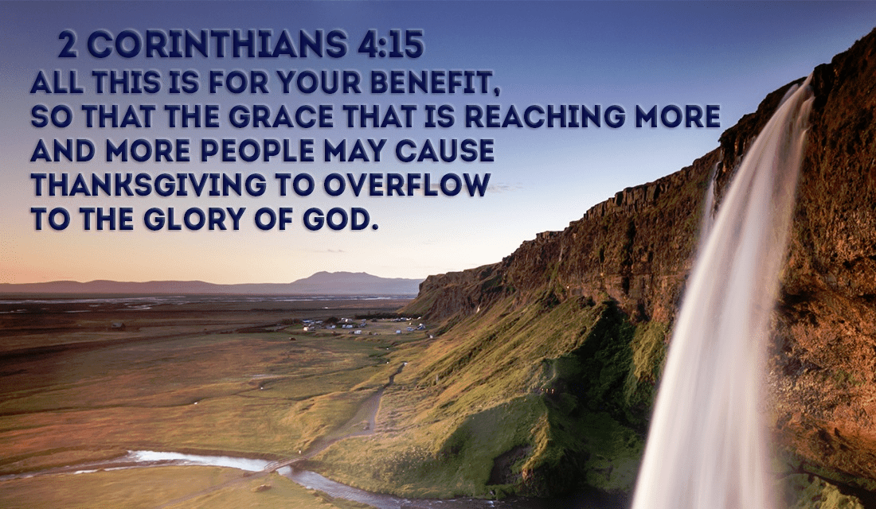

Slide 5
Reasons Why We Should Be Thankful
2. Because it is commanded in Scripture.
First, the Psalms are filled with the call to give thanks. An example is Ps. 100:4 which says, "Enter his gates with thanksgiving and his courts with praise; give thanks to him and praise his name."

Slide 6
Reasons Why We Should Be Thankful
2. Because it is commanded in Scripture.
Then Paul tells us in 1 Thessalonians 5:18, "In everything keep on giving thanks, for this is the will of God in Christ Jesus for you" (my translation). In Colossians, he twice gives the command to be thankful (3:15, 17).

Slide 7
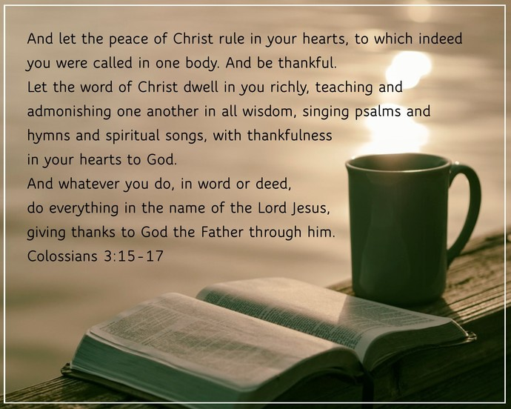

Slide 8
Reasons Why We Should Be Thankful
3. Because of the dangerous consequences of thanklessness:
Thanklessness is dangerous to self and others. It dishonors God and leads to proud humanism or dependence on man rather than God (cf. Rom. 1:21).

Slide 9
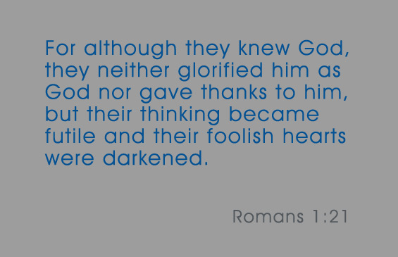

Slide 10
Reasons Why We Should Be Thankful
3. Because of the dangerous consequences of thanklessness:
In addition, it leads to bitterness, complaining, and a joyless life (Heb. 12:15). Since thankfulness is a response to the grace of God, its opposite, bitterness with its companions, complaining and grumbling, are the product of an unthankful heart that fails to properly

Slide 11
Reasons Why We Should Be Thankful
3. Because of the dangerous consequences of thanklessness:
respond to God in faith to His person, infinite wisdom, grace and purposes. Thanklessness promotes pettiness and occupation with self, people, and problems. That in turn creates depression and feelings of hopelessness because

Slide 12
Reasons Why We Should Be Thankful
3. Because of the dangerous consequences of thanklessness:
we become focused on our problems rather than on the Lord.

Slide 13
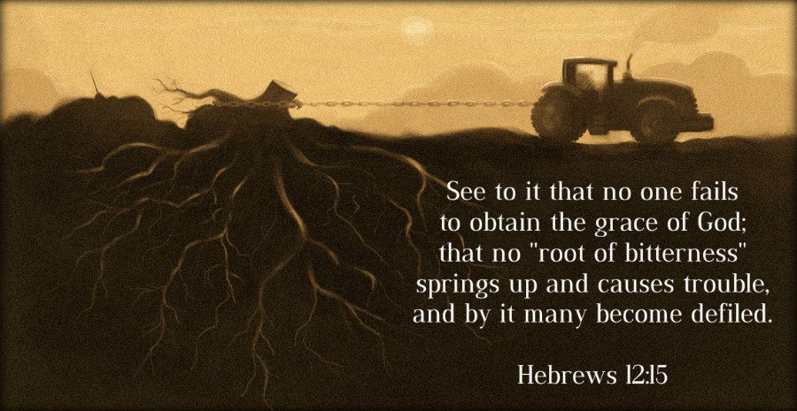

Slide 14
Reasons Why We Should Be Thankful
But thanks be to God who always leads us in triumphal procession in Christ and who makes known through us the fragrance that consists of the knowledge of him in every place (2 Cor. 2:14).

Slide 15
Reasons Why We Should Be Thankful
This verse in 2 Corinthians demonstrates that a thankful and God-focused person counts on God and His triumph and will manifests the sweet fragrance of a life filled with the knowledge of Christ rather than the spirit of bitterness and complaining.

Slide 16
Reasons Why We Should Be Thankful
Thankfulness, then, becomes a spiritual barometer; it is an evidence of the condition of our spiritual life and value system, which should give us a warning if we have ears to hear.

Slide 17
Reasons Why We Should Be Thankful
Eph. 5:4 & 20 and note the context of each verse. For verse 4, the context or focus is living as children of God rather than as children of the world [cf. vs.1]; for verse 20, the context or focus is the fruit of the Spirit [cf. vs. 18]).

Slide 18
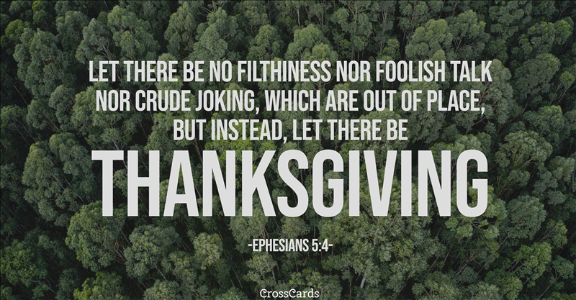

Slide 19
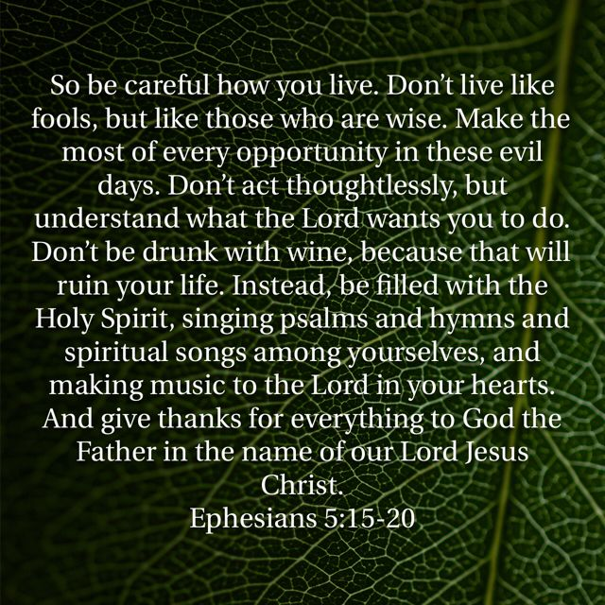

Slide 20
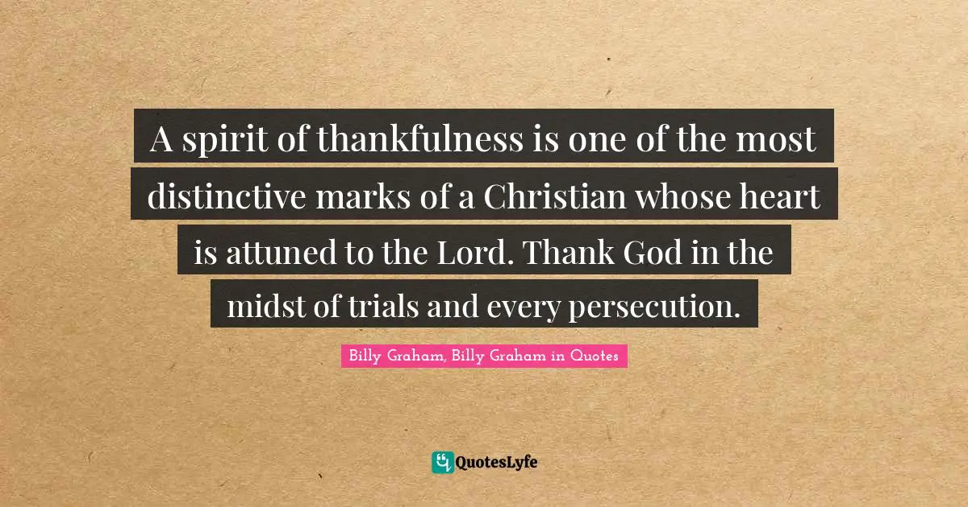

Slide 21
