Slide 3
2 Corinthians 10:3-5
³ For though we live in the world, we do not wage war as the world does. ⁴ The weapons we fight with are not the weapons of the world. On the contrary, they have divine power to demolish strongholds. ⁵ We demolish arguments and every pretension that sets itself up against the knowledge of God, and we take captive every thought to make it obedient to Christ.

Slide 4
1.Safeguard
your mind
against LIES

Slide 5
2 Corinthians 10:3-5
³ For though we live in the world, we do not wage war as the world does. ⁴ The weapons we fight with are not the weapons of the world. On the contrary, they have divine power to demolish strongholds. ⁵ We demolish arguments and every pretension that sets itself up against the knowledge of God, and we take captive every thought to make it obedient to Christ.

Slide 6
John 8:44
⁴⁴ You belong to your father, the devil, and you want to carry out your father’s desires. He was a murderer from the beginning, not holding to the truth, for there is no truth in him. When he lies, he speaks his native language, for he is a liar and the father of lies.

Slide 7
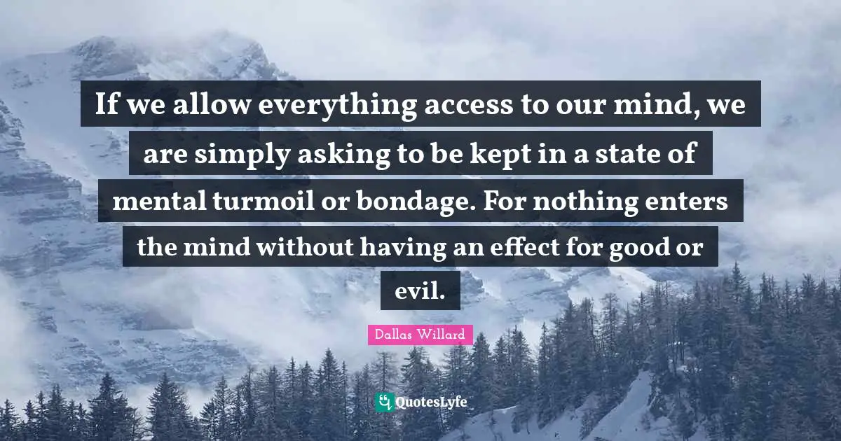

Slide 10
2. Protect
your mind
against FEAR

Slide 11
2 Timothy 1:7
⁷ For God has not given us a spirit of fear, but of power and of love and of a sound mind.

Slide 12
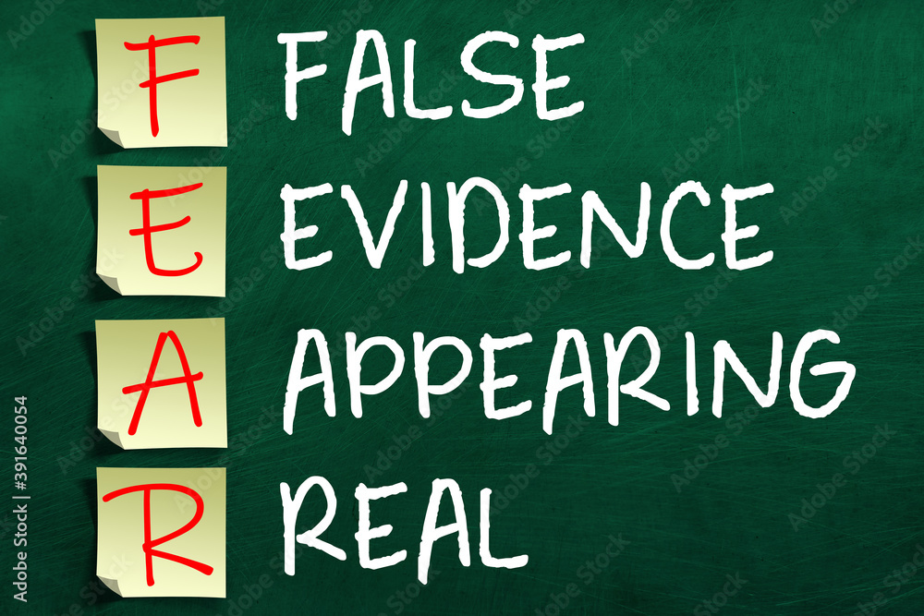

Slide 13
Faith is the antidote for fear. Peace is a by-product of faith. But peace is something we must choose to take continually. True peace comes from choosing to place our faith in God on a daily basis.
Just as the Israelites were not able to store manna for the future, so it is with emotional and spiritual peace. Each day we gain a supply that meets our need for that day. –See Exodus 16:14-20
If peace came in a life-time supply we would be tempted to fall into the trap of self-sufficiency.
Peace is found by confidently exercising our faith in God’s plan for us on a daily basis. By confidently trusting him for all we need for this day and forever. See Hebrews 4:16

Slide 14
3. Guard against the
world’s INFLUENCES

Slide 17
James 4:4 (NLT)
⁴ You adulterers! Don’t you realize that friendship with the world makes you an enemy of God? I say it again: If you want to be a friend of the world, you make yourself an enemy of God.

Slide 20
² Set your minds on things above, not on earthly things.
Colossians 3:2

Slide 21
² Do not conform to the pattern of this world, but be transformed by the renewing of your mind.
Romans 12:2 (NIV)

Slide 22
The things we value most should be things that are above – spiritual things such as the Bible, prayer, the Gospel, obedience to God, God Himself.

Slide 23
4. Shield your mind against NEGATIVITY.

Slide 24
⁵ Why, my soul, are you downcast? Why so disturbed within me? Put your hope in God,
Psalm 42:5

Slide 25
⁸ Christian brothers, keep your minds thinking about whatever is true, whatever is respected, whatever is right, whatever is pure, whatever can be loved, and whatever is well thought of. If there is anything good and worth giving thanks for, think about these things. ⁹ Keep on doing all the things you learned and received and heard from me. Do the things you saw me do. Then the God Who gives peace will be with you.
Philippians 4:8-9
New Life Version

Slide 26
⁶ If your sinful old self is the boss over your mind, it leads to death. But if the Holy Spirit is the boss over your mind, it leads to life and peace.
Romans 8:6
New Life Version

Slide 27
“If you would protect your body, guard your mind. If you would renew your body, beautify your mind. Thoughts of malice, envy, disappointment, despondency, rob the body of its health and grace.”
- James Allen-

