Slide 1
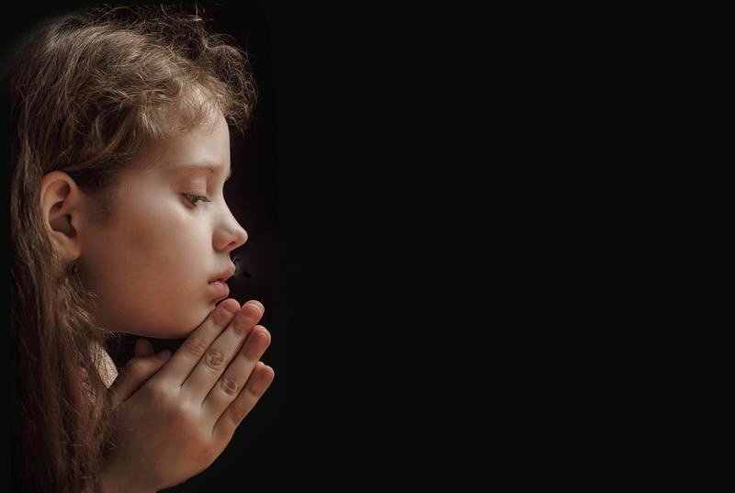
The Importance of Watching and Praying
Luke 21:34-36

Slide 2
“But take heed to yourselves, lest your hearts be weighed down with carousing, drunkenness, and cares of this life, and that Day come on you unexpectedly. For it will come as a snare on all those who dwell on the face of the whole earth. Watch therefore, and pray always that you may be counted worthy to escape all these things that will come to pass and to stand before the Son of Man.” (Luke 21:34-36)

Slide 3
Contemporary English Version
34 Don't spend all of your time thinking about eating or drinking or worrying about life. If you do, the final day will suddenly catch you 35 like a trap. This day will surprise everyone on earth. 36 Watch out and keep praying that you can escape all that is going to happen and that the Son of Man will be pleased with you. (Luke 21:34-36)

Slide 4
Jesus lists three things that can weigh down our hearts; (1) carousing; (2) drunkenness; and (3) the cares of this life. The expression “that Day” refers to the end time and the day of the Lord’s return. “Watch therefore” means I am warning you.

Slide 5
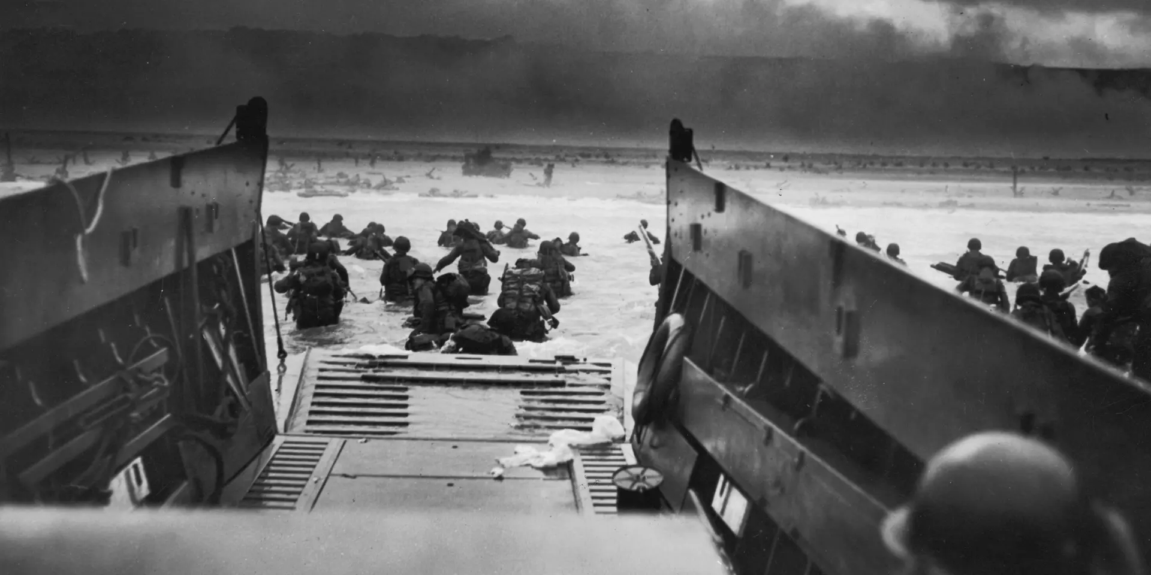

Slide 6
In Matthew 24:36-39 Jesus tells that: “But about that day or hour no one knows, not even the angels in heaven, nor the Son, but only the Father. As it was in the days of Noah, so it will be at the coming of the Son of Man. For in the days before the flood, people were eating and drinking, marrying and giving in marriage, up to the day Noah entered the ark; and they knew nothing about what would happen until the flood came and took them all away. That is how it will be at the coming of the Son of Man.”

Slide 7
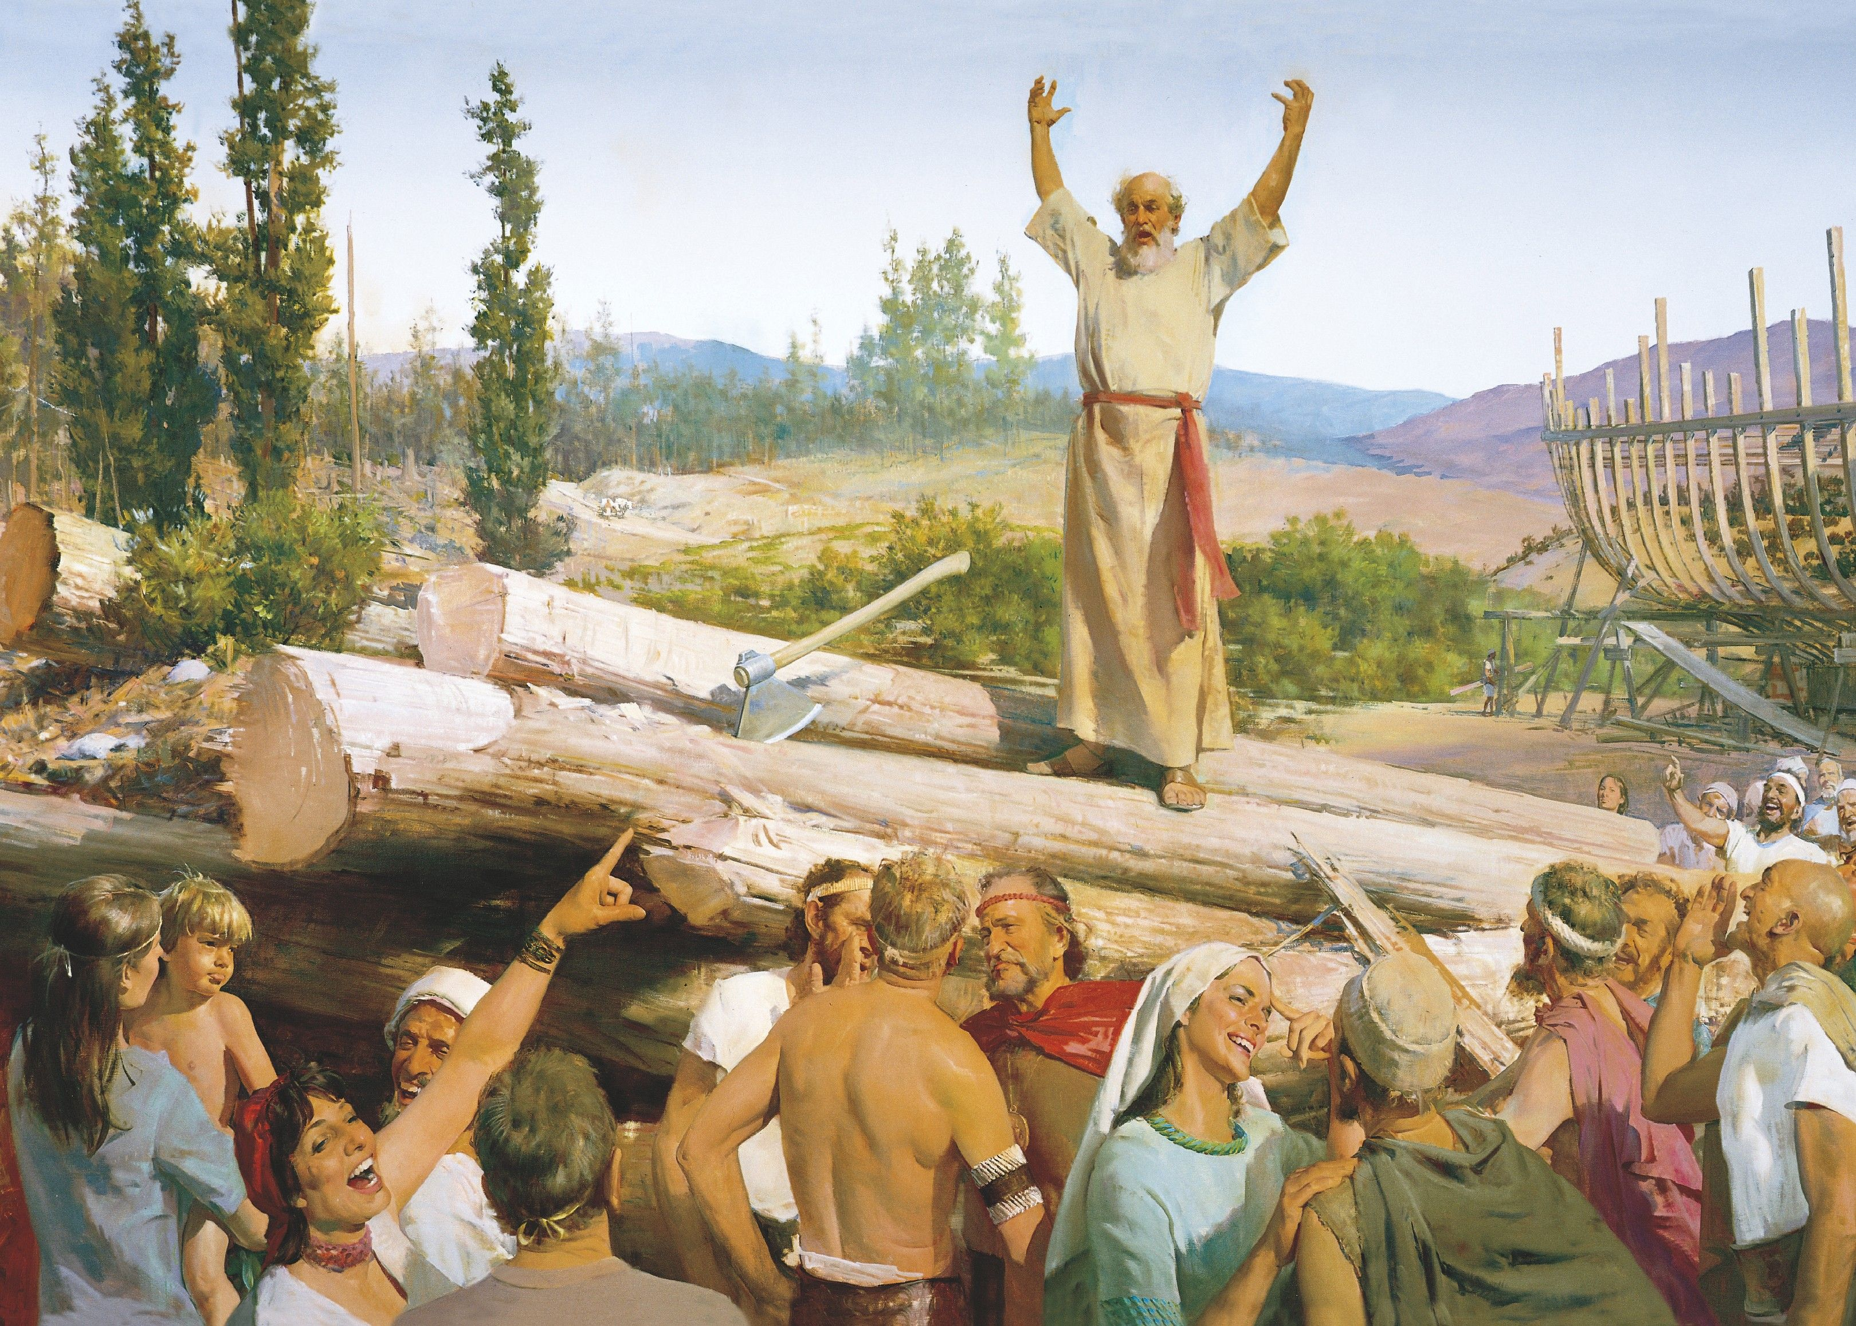

Slide 8
A true believer wants to live in such anticipation of the coming of Christ that their heart is not burdened down with sin. The Apostle John put it this way in
1 John 2:28; “And now, little children, abide in Him, that when He appears, we may have confidence and not be ashamed before Him at His coming.”

Slide 9
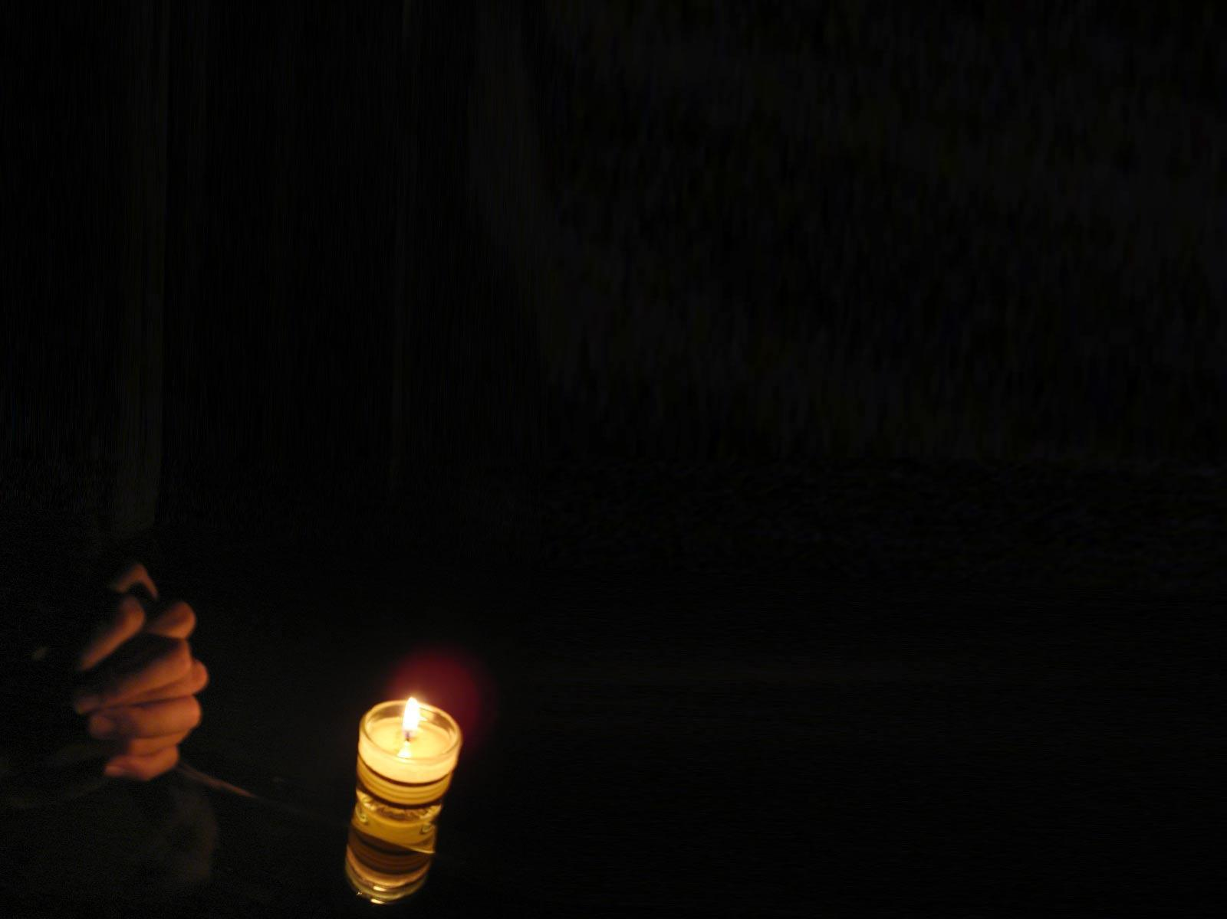
In the Garden of Gethsemane Jesus asked His disciples to “stay here and watch with Me”, but when He returned, He found them asleep and caution them “Watch and pray, lest you enter into temptation. The spirit indeed is willing, but the flesh is weak” (Matthew 26:41).

Slide 10
We need to watch and pray so that God causes those who are faithful to be counted worthy.
Our faith, our watching and praying, our confidence in Christ’s return is counted as righteousness. Just like when Abraham believed God and it was counted to him as righteousness.

Slide 11
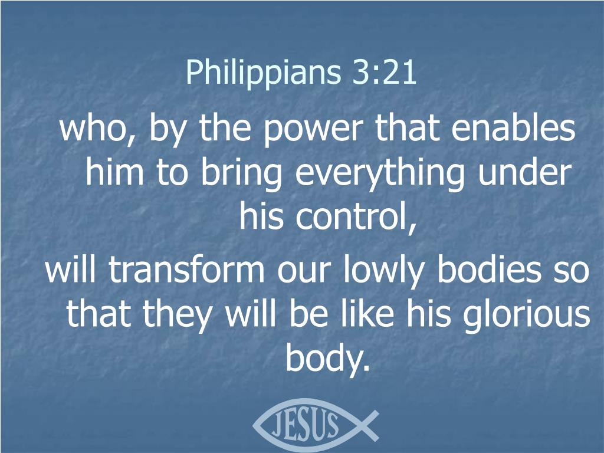

Slide 12
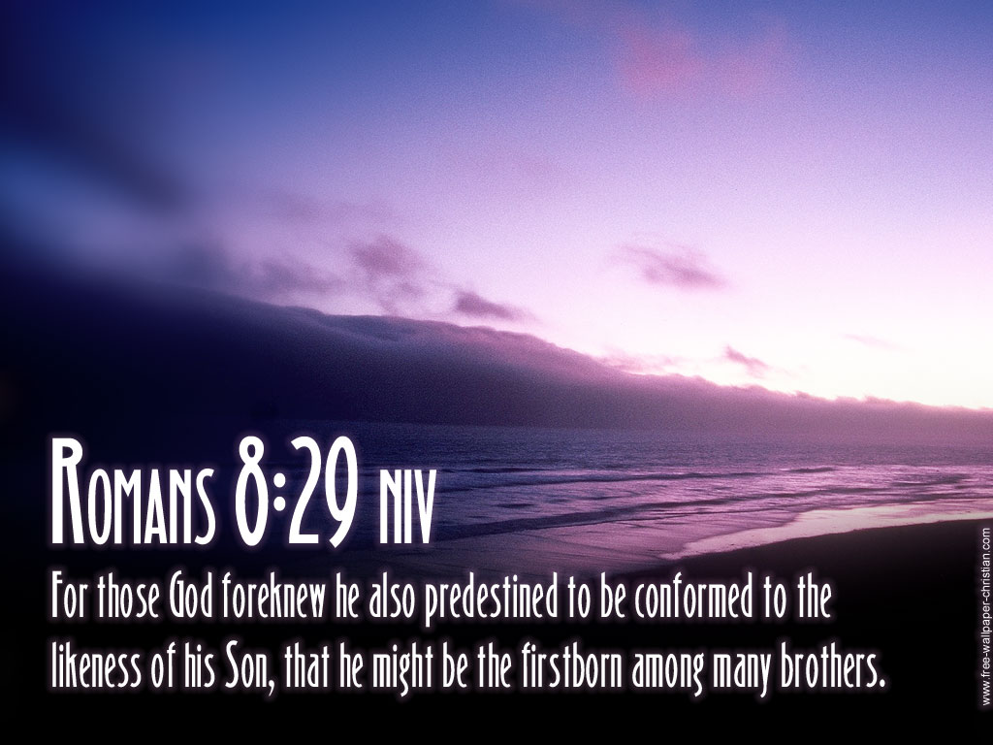

Slide 13
The weapon that Jesus used to overcome was prayer and God’s Word. Jesus’ disciples today must also watch and pray. We are easily distracted by this world, our fleshly needs and desires, and the schemes of the enemy
(2 Corinthians 2:11).

Slide 14
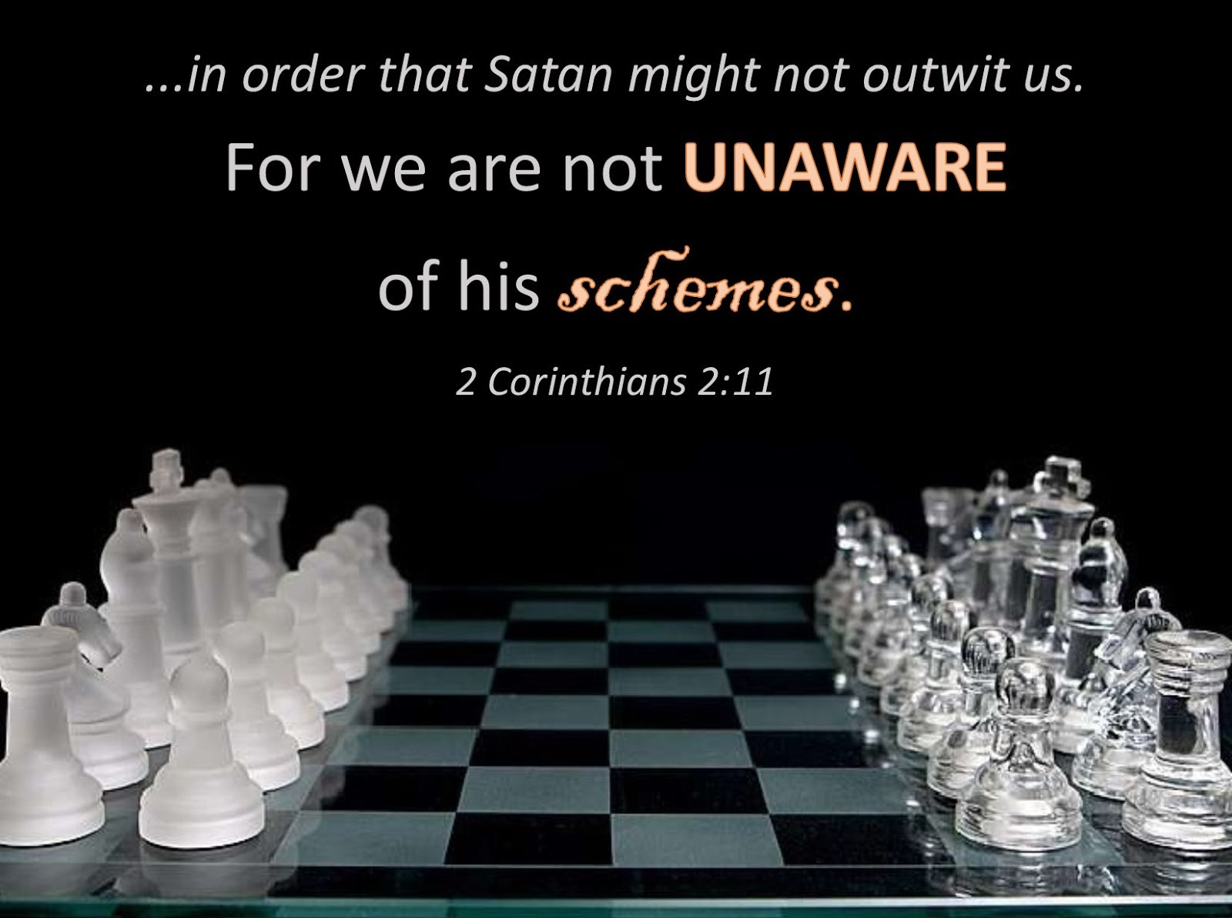

Slide 15
When we take our eyes from Jesus and His soon return, our values begin to shift, our attention wanders, and soon we are living like the world and bearing little fruit for God’s kingdom (1 Timothy 6:18–19).

Slide 16
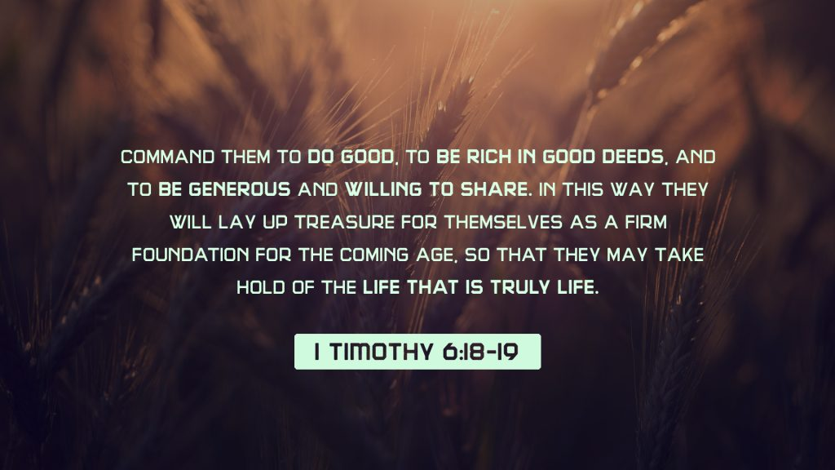

Slide 17
He warned us that we must be ready at any moment to stand before Him and give an account of our lives (Romans 14:12; 1 Peter 4:5)

Slide 18
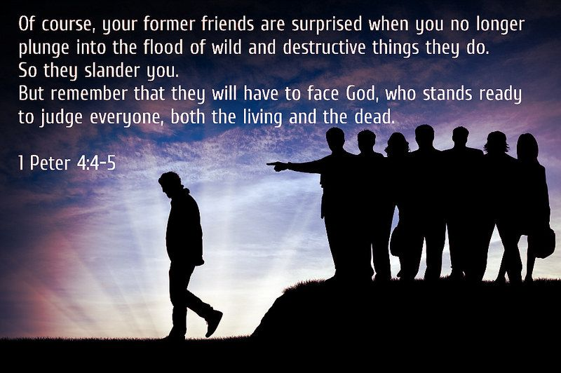

Slide 19
“Watch and pray.” We can only remain faithful when we are devoted to prayer. In order to keep watch, we must pray for endurance and freedom from distractions (John 14:14). When we live with the eager expectation of the Lord’s return, we are more likely to keep our lives pure and our hearts ready to meet Him.

Slide 20
Vigilance leads to holiness and we want to live with a clear conscience so that when the Lord comes we can meet Him with a clear and pure mind. It means that we need to have a constant connection with God and seek Him to have power to overcome all sin.

Slide 21
"Watching is a function of discernment. You must sustain a heightened discernment to maneuver the strategies of darkness. The devil is vigilant and launches his attacks during one's weakest points"

Slide 22
