Slide 3
The Christian’s response to economic crisis
Matthew 6:33

Slide 5
1. Trust in God's Sovereignty:
The Bible teaches that God is in control, even during difficult times, and that "all things work together for good to those who love God" (Romans 8:28).

Slide 6
Psalm 103:19
The Lord has established His throne in the heavens, And His sovereignty rules over all.

Slide 9
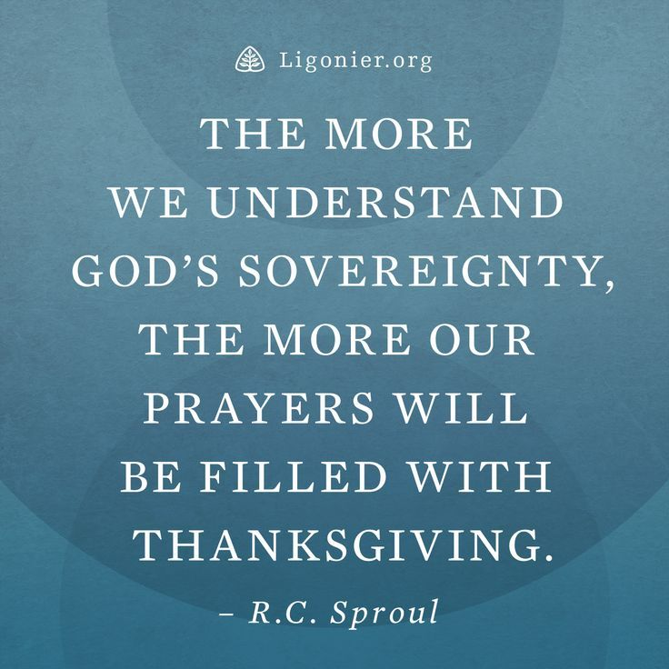

Slide 10
2. Seek God's Wisdom:
In times of uncertainty, it's crucial to seek God's guidance and wisdom through prayer and studying scripture.

Slide 11
James 1:5 New English Translation
5 But if anyone is deficient in wisdom, he should ask God, who gives to all generously and without reprimand, and it will be given to him.

Slide 12
Wisdom can be defined as seeing a situation as God does. Acting on it as God wills and learning from it as God intended all along
- Timm Artus

Slide 13
3. Practice Generosity:
The Bible encourages giving and helping others, even during a recession, as a way to demonstrate faith and trust in God's provision.

Slide 15
Proverbs 11:25 The Voice
A giving person will receive much in return,
and someone who gives water will also receive the water he needs.

Slide 16
4. Be Content:
Focus on what you have and be grateful for God's blessings, rather than dwelling on what you lack.

Slide 17
Hebrews 13:5
Keep your lives free from the love of money and be content with what you have, because God has said, “Never will I leave you; never will I forsake you.”

Slide 19
5. Remember God's Promises:
Reflect on God's promises of faithfulness and provision, which can bring comfort and strength during challenging times.

Slide 20
God’s promises are not always fulfilled as quickly as or in the way we might hope; they come according to His timing and His ways.
-Dieter F. Uchtdorf

Slide 21
6. Don't Fear:
The Bible encourages believers to not fear, but to trust in God's strength and ability to see them through any hardship.

Slide 22
Isaiah 41:10 –
Fear not, for I am with you; be not dismayed, for I am your God; I will strengthen you, I will help you, I will uphold you with my righteous right hand.

Slide 24
Luke 12:32 New International Version
32 “Do not be afraid, little flock, for your Father has been pleased to give you the kingdom.

Slide 25
7. Focus on Spiritual Growth:
Use this time to deepen your faith and relationship with God through prayer, Bible study, and fellowship with other believers

Slide 26
“True spiritual growth comes from talking to, listening to and obeying the voice of the Holy Spirit”

Slide 27
Philippians 4:6-7 CEV
6 Don't worry about anything, but pray about everything. With thankful hearts offer up your prayers and requests to God. 7 Then, because you belong to Christ Jesus, God will bless you with peace that no one can completely understand. And this peace will control the way you think and feel.

Slide 28
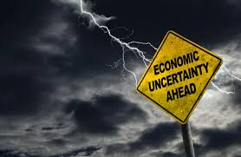
“When things go wrong it’s an opportunity to trust God that He is in control”

