Slide 2
God’s purpose for the family.

Slide 3
Genesis 2:18-25 (NLT)
¹⁸ Then the Lord God said, “It is not good for the man to be alone. I will make a helper who is just right for him.”
Genesis 2:18-25 (NIV)
¹⁸ The Lord God said, “It is not good for the man to be alone. I will make a helper suitable for him.”
Genesis 2:18-25 (ESV)
¹⁸ Then the Lord God said, “It is not good that the man should be alone; I will make him a helper fit for him.”

Slide 4
Genesis 2:21-22 (NIV)
21 So the Lord God caused the man to fall into a deep sleep; and while he was sleeping, he took one of the man’s ribs and then closed up the place with flesh. 22 Then the Lord God made a woman from the rib he had taken out of the man, and he brought her to the man.

Slide 5
God blessed them and they became one flesh, thus, started the family. The first purpose for them was to pro-create and become stewards of the other creations (Genesis 1:28)

Slide 6
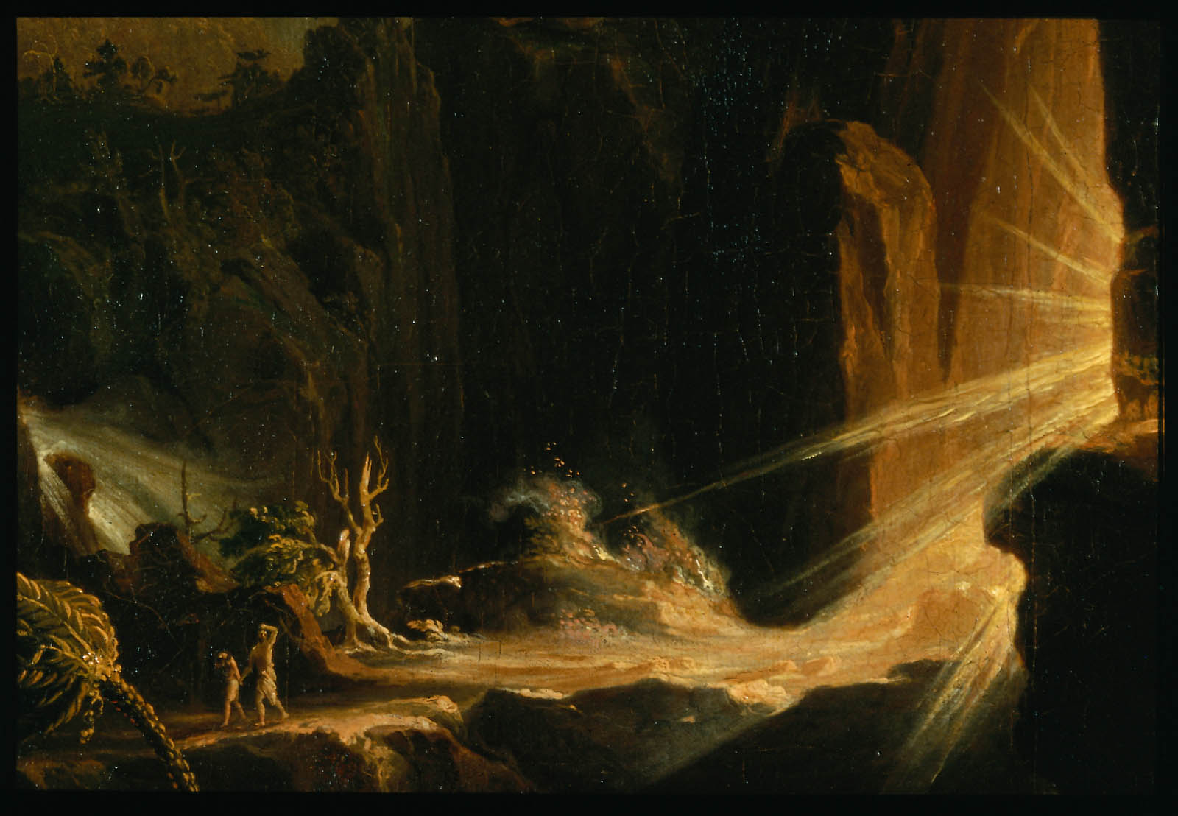
Everything was perfectly fine until sin entered the world. Life became different. They needed to work in order to eat. They needed to exert physical efforts in order to live. They needed to till the soil for crops and tend animals for dairy products.

Slide 7
1 Timothy 5:8 (NLT)
⁸ But those who won’t care for their relatives, especially those in their own household, have denied the true faith. Such people are worse than unbelievers.

Slide 8
The most important role of parents is to provide for the spiritual needs of all members of the family.

Slide 9
It is the utmost duty of parents to teach their children the ways of the Lord, so when their children grow older, they would never depart from it (Proverbs 22:6).

Slide 10
In accepting the spiritual duties of every member of the family, the purpose of God for having a family is sanctified.

Slide 11
In 2024, domestic violence in Canada has included a rise in femicides and family violence, as well as calls for urgent action.
Femicides
As of November 25, 2024, there have been 163 femicides of women and girls in Canada, which is 12 more than the same time in 2023.
Guns are one of the most common methods used to commit these murders.
Femicides often represent the culmination of gender-based violence, which can include physical, sexual, or emotional abuse.

Slide 12
Family violence
Family violence is highest in the northern regions of Canada, including British Columbia, Alberta, Saskatchewan, Manitoba, Ontario, Quebec, Newfoundland and Labrador, and the territories.
Rates of family violence and intimate partner violence were higher in 2023 than in 2018.

Slide 13
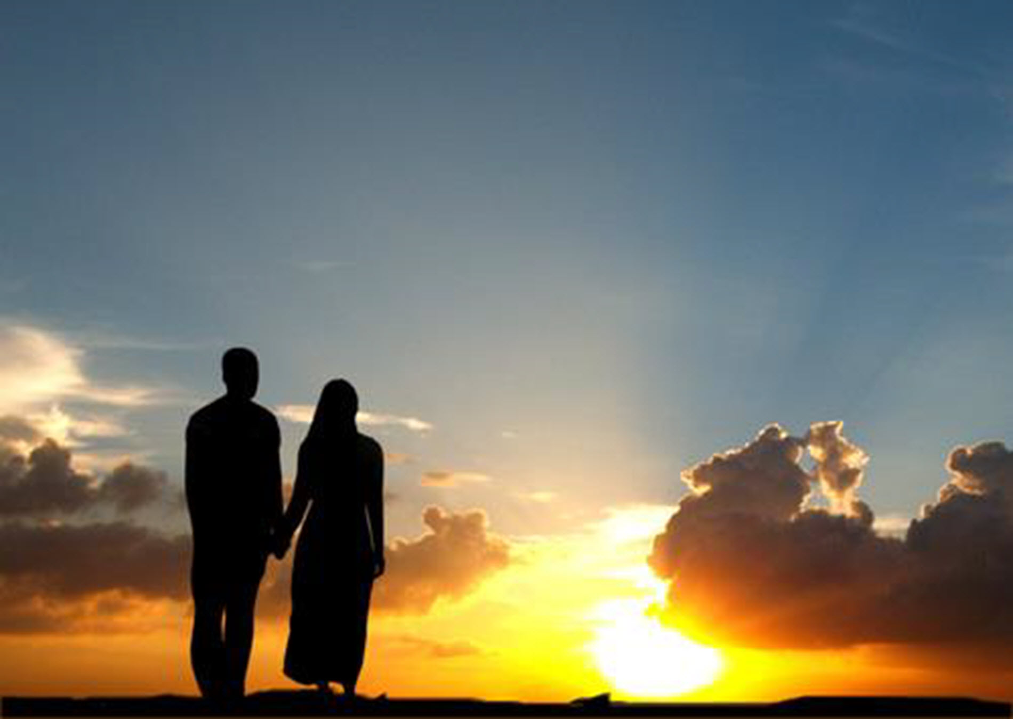
For both husband and wife, their duties are to remain faithful and loving to one another whatever happens in their life. They need to respect the sanctity of marriage and fulfill marital duties to one another
(1 Corinthians 7:3-4).

Slide 14
Hebrews 13:4 (NLT)
4 Give honor to marriage, and remain faithful to one another in marriage. God will surely judge people who are immoral and those who commit adultery.

Slide 15
For wives, they should submit themselves to their husbands, and learn to be reverent in the way they live, not to be slanderers or addicted to much wine, but to teach what is good. Then they can urge the younger women to love their husbands and children, to be self- controlled and pure, to be busy at home, to be kind, and to be subject to their husbands, so that no one will malign the word of God (Ephesians 5:22; Titus 2:3-5).

Slide 16
1 Peter 3:1-4 (NIV)
3 Wives, in the same way submit yourselves to your own husbands so that, if any of them do not believe the word, they may be won over without words by the behavior of their wives, ² when they see the purity and reverence of your lives. ³ Your beauty should not come from outward adornment, such as elaborate hairstyles and the wearing of gold jewelry or fine clothes. ⁴ Rather, it should be that of your inner self, the unfading beauty of a gentle and quiet spirit, which is of great worth in God’s sight.

Slide 17
1 Peter 3:7 New International Version
7 Husbands, in the same way be considerate as you live with your wives, and treat them with respect as the weaker partner and as heirs with you of the gracious gift of life, so that nothing will hinder your prayers.

Slide 18
Ephesians 6:1-3
New International Version
6 Children, obey your parents in the Lord, for this is right. 2 “Honor your father and mother”—which is the first commandment with a promise— 3 “so that it may go well with you and that you may enjoy long life on the earth.”[a]

Slide 19
Above all, the purpose of having a family is to express love, respect and sacrifice for one another. If we are planning to have our own family, prepare to love, to give respect and to create sacrifices for others.

