Slide 1
WHAT MATTERS THE MOST
Matthew 22:34-40

Slide 2
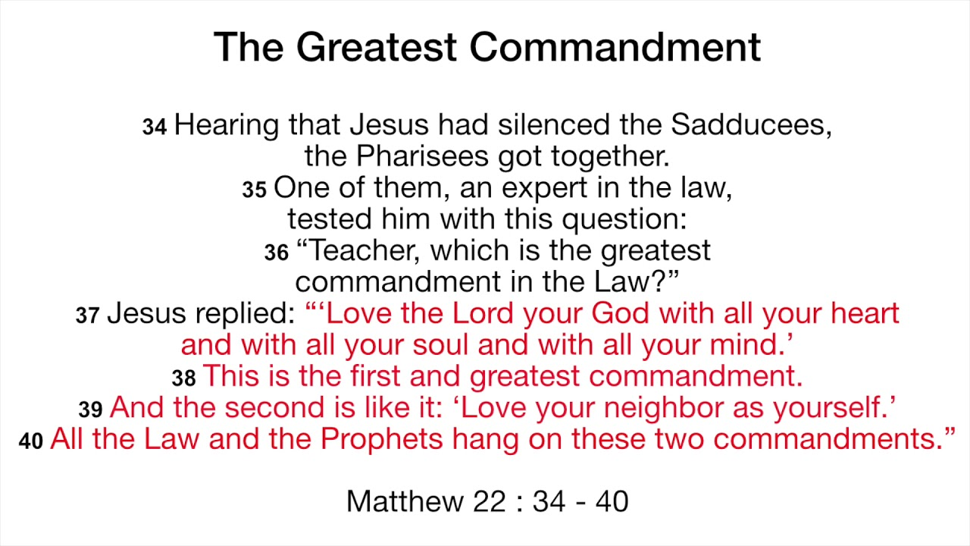

Slide 3
I. What is happening here?
Tested - The enemies of Jesus has only plan and that is trap him and eventually put him away for good.
Opposed – The enemies would like bring down Jesus
Being Trapped – expert in the Jewish law came up with a “question”

Slide 4
“Teacher, which is the greatest
commandment in the Law?”
*Exodus 20:1-17
*The law is the basis of the relationship
between God and His people Israel
*The Law is central to the Jewish
consciousness

Slide 5
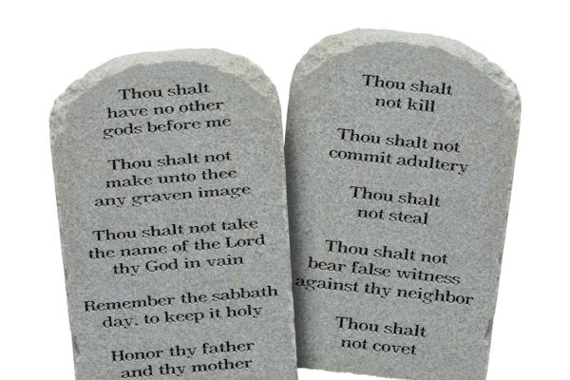
From 10 Laws, it was expanded to 613 laws, and it seems Jesus summarized everything into 2 Laws

Slide 6

II. What does it mean to truly love God?
Jesus answered beyond what was asked.
He wanted the people to understand beyond the letters of the Law
“ You shall love the Lord your God with all your heart , and with all your soul , and with all your mind .”

Slide 7
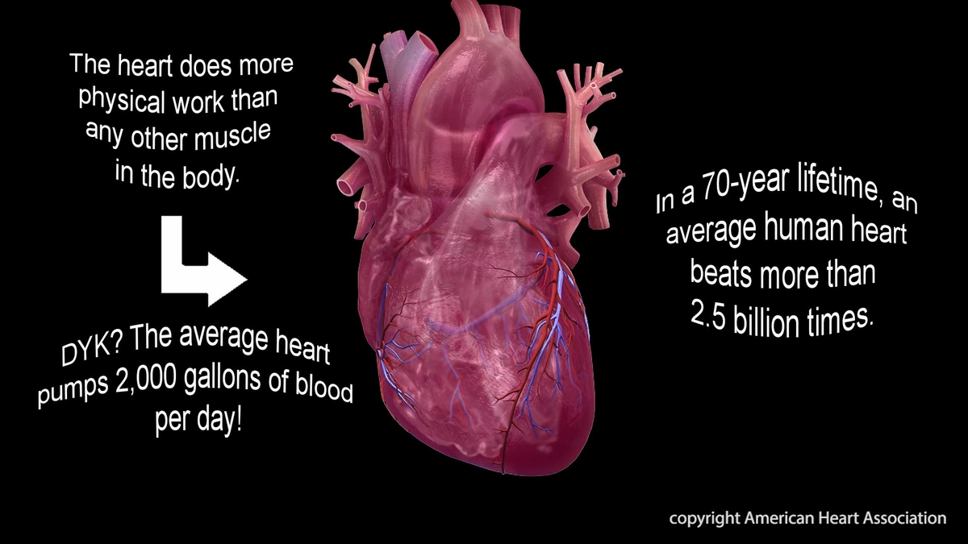
“ With all your heart”

Slide 8
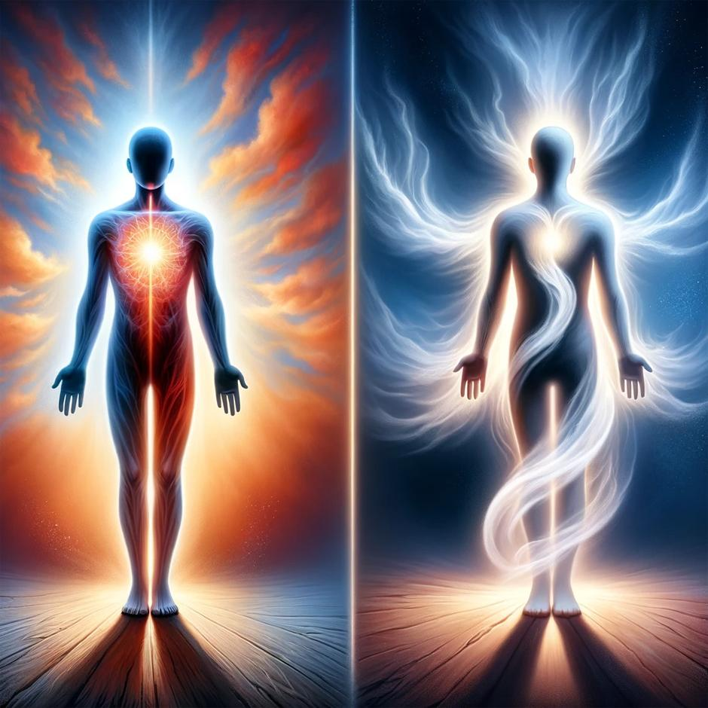
“With all your soul”
The soul is the immaterial or the spiritual part of man that survives death
Gen. 2:7: “…and the man came to be a living soul.”

Slide 9
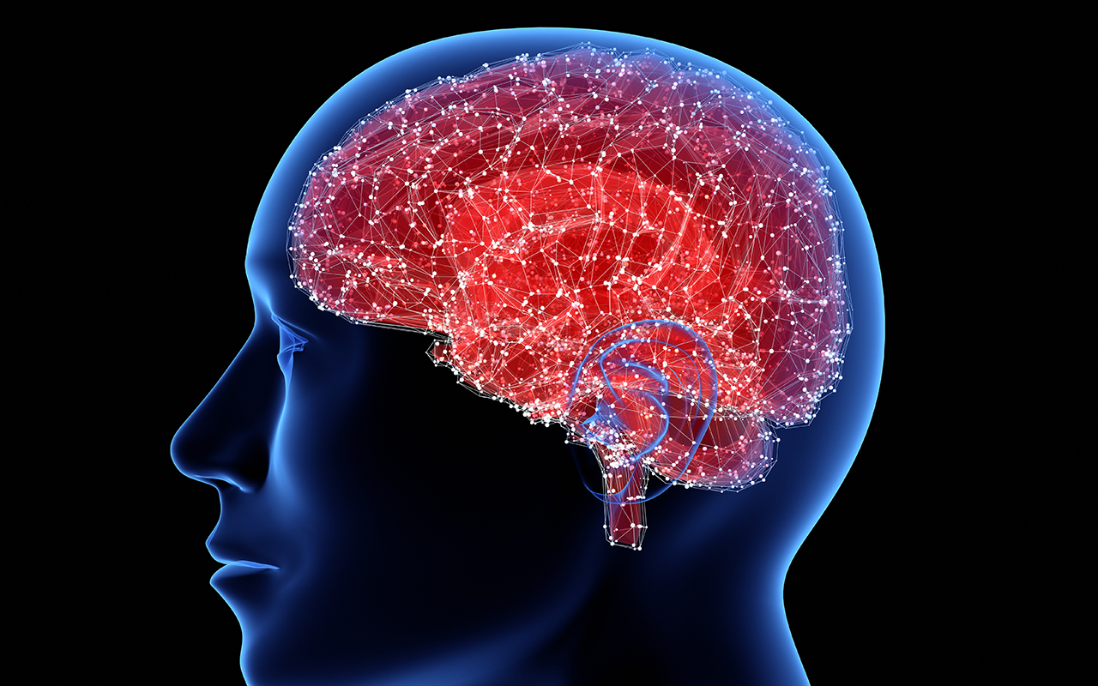
“ With all your mind”
Our relationship with God is not just an emotional experience but also choice. There are around 10 billion nerve cells

Slide 10

This means making God the FOCUS Of our Life and Existence

Slide 11
The Meaning of Love
• Sometimes phileo is translated “love” in the NT, meaning a friendship or companionship (a love of emotion)
• Often agape is translated “love” in the NT, meaning sacrificial service or kind deed (a love of devotion)
• The agape love is what Jesus speaks of in Matthew 22:37-39

Slide 12
The Model of Love
• God the Father is our model of love in that he sacrificed his Son for us out of love (Jn. 3:16; 1 Jn. 3:1,16)
• Jesus Christ is our model of love because he gave himself to die out of love (Jn. 13:34; 15:13; Gal. 2:20; Eph. 5:2,25)
• The world around us is not our model of love

Slide 13
The Manifestation of Love
• We show our love for God by keeping his commandments (1 Jn. 5:2)
• We show our love for Jesus by sincerely serving him (Ephesians 6:7; John 12:26)
• We show our love for our brethren by caring for them (Rom. 12:10; 1 Thess. 4:9; Heb. 13:1; 1 Jn. 3:14,17; 4:20)

Slide 14
The Manifestation of Love
• We show our love for our neighbor by respecting them as we would ourselves (Mt. 22:39; Lk. 10:27; Rom. 13:8-10; Gal. 5:14; Jas. 2:8)
• We show our love for our enemies by praying for them and doing good to them (Mt. 5:44; Rom. 12:20-21)

Slide 15
The Magnitude of Love
• Loving God is the “great and first” commandment because when we truly love God everything else he wants us to do will follow from it (Mt. 22:40)
• Loving God is the “greatest” (the greater) because it is permanent and lasting (1 Cor. 13:8,13) and from it springs our all actions in the local church (1 Cor. 12:31; 13:1-3; 14:1)
• Do you have trouble obeying some of God’s commands? Baptism? Assembling? Contribution? Lord’s supper? Evangelism? (Biblical) Love is the answer!

Slide 16
