Slide 1
THE IMPORTANCE OF PRAYER

Slide 2
“No one can believe how powerful prayer is and what it can effect, except those who have learned it by experience. Whenever we have prayed earnestly, we have been heard and have obtained more than we prayed for. God sometimes delays, but He always comes.”
- Martin Luther-

Slide 3
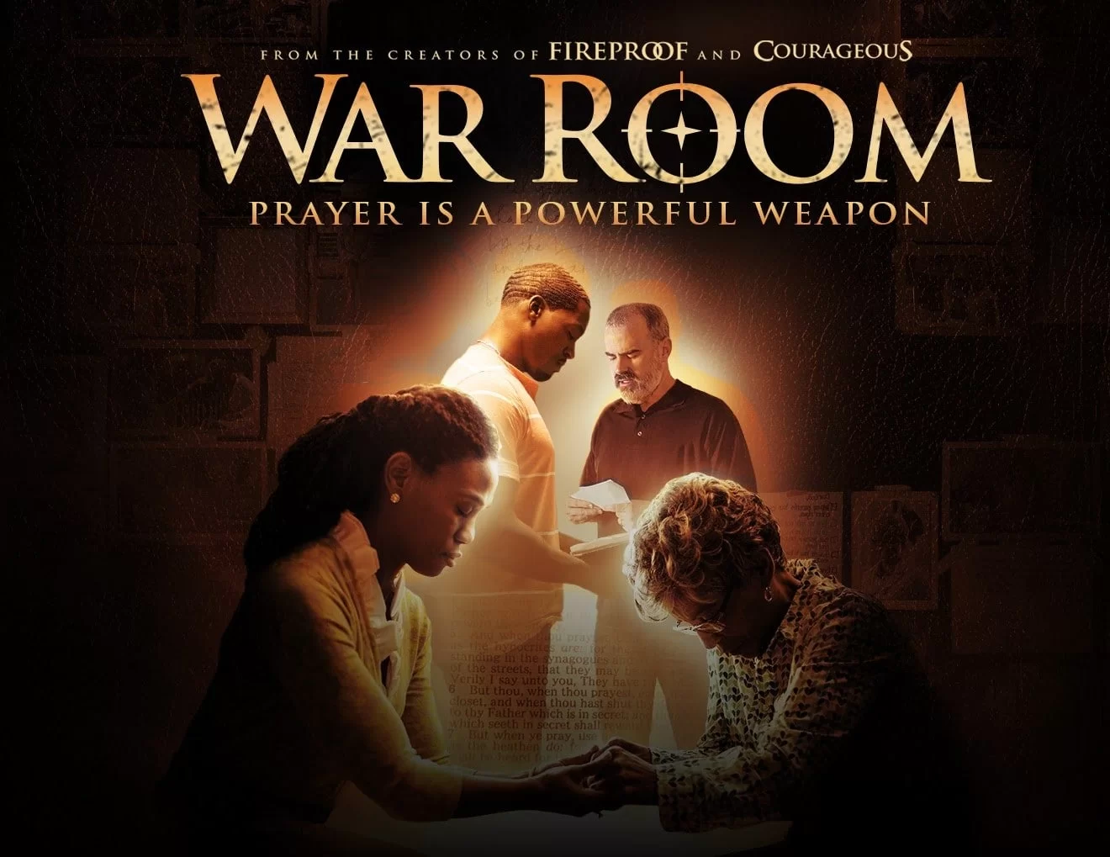

Slide 4
“Prayer is to the Christian what breath is to life, yet no duty of the Christian is so neglected.”
-R.C. Sproul-

Slide 5
Why is Prayer so Important?
Besides the fact that we are commanded to pray (Colossians 4:2), we’ll find that prayer is a sort of umbilical cord connecting us to God. It is in our abiding in Christ that we are nourished and in constant union with Him.

Slide 6
If you want that splendid power in prayer, you must remain in loving, abiding union with the Lord Jesus Christ.
- C.H. Spurgeon

Slide 7
PRAYER IS HOW WE COMMUNICATE WITH GOD
Jeremiah 29:12 says, “Then you will call on me and come and pray to me, and I will listen to you”.
God is attentive to his children and wants us to come and talk to him about everything that’s on our mind.

Slide 8
“True prayer should pour out the whole soul and every inward feeling before him.”
-John Calvin-

Slide 9
PRAYER IS WHERE WE GET OUR STRENGTH
David cried out to God in Psalm 22:19: “But you, Lord, do not be far from me. You are my strength; come quickly to help me”.
After being in God’s presence for a time we often come away feeling energized, confident and ready to face the day.

Slide 10
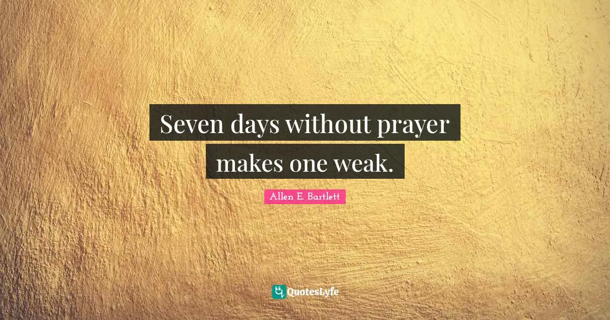

Slide 11
PRAYER IS HOW WE BATTLE IN THE SPIRITUAL WORLD
Some of us rarely experience victory because we fail to recognize what we’re really up against: “against the rulers, against the authorities, against the powers of this dark world and against the spiritual forces of evil in the heavenly realms”.

Slide 12
PRAYER IS HOW WE BATTLE IN THE SPIRITUAL WORLD
As we put on our armor in the presence of God each day, we prepare for battle. If we don’t put it on, we will be defeated as Satan attacks our heart and mind at every turn. We must be in the Word and prayer.

Slide 13
“Relying on God has to begin all over again every day as if nothing had yet been done.”
-C.S. Lewis-

Slide 14
PRAYER IS HOW WE STAND IN THE GAP FOR OTHERS
To “stand in the gap” means to intercede on behalf of others and plead for God’s mercy. Ephesians 6:18 tells us to “be alert and always keep on praying for all the Lord’s people”.

Slide 15
PRAYER IS HOW WE STAND IN THE GAP FOR OTHERS
It is our special ministry to advocate for the lost, the persecuted and those enslaved by sin, in the same way that Moses stood in the gap for the Israelites in Exodus 32.

Slide 16
PRAYER IS WHERE WE SURRENDER OUR BURDENS
When we think of burdens we think of something that is heavy, almost unbearable. God takes a special interest in our burdens, namely, the things that worry us. Jesus earnestly invites all those who are “weary and with heavy burdens” to come to Him.

Slide 17
“Prayer is the center of the Christian life. It is the only necessary thing. It is living with God in the here and now.”
-Henri Nouwen

Slide 18
PRAYER IS HOW WE FIGHT TEMPTATION
“Watch and pray so that you will not fall into temptation. The spirit is willing, but the flesh is weak.”(Matthew 26:42 NIV). Jesus said this to his disciples just before going into the Garden of Gethsemane to pray. We all have areas in our lives where we are weak and vulnerable to certain sins.

Slide 19
PRAYER IS WHERE GOD CHANGES OUR HEART AND MIND
The more time we spend in the Word and in the presence of God through prayer, the more our hearts will resemble that of Christ’s. It is unavoidable. Why? Because we no longer have to strive to be like Jesus in our own strength. We don’t have to work for it. We just have to allow God to speak to us and change us as we walk in obedience by faith.

Slide 20
“As well could you expect a plant to grow without air and water as to expect your heart to grow without prayer and faith.”
-C.H. Spurgeon

Slide 21
PRAYER IS WHERE WE REPENT AND EXPRESS OUR BROKENNESS
We sin every day, and we will struggle with sin continuously until God calls us home. It’s important that we confess our sins daily before the Lord during our time of prayer. If we don’t we will begin to lose our sensitivity to sin and its effects, and begin to cherish sinful habits in our hearts.

Slide 22
PRAYER IS HOW BELIEVERS ARE UNIFIED
There are a number of instances in the book of Acts that give us example that priority should be given to corporate prayer. Miracles happened when believers pray together!

Slide 23
“If prayer was so important to the incarnate Son of the living God, then how much more important should prayer be to us?”
~Paul Washer

Slide 24
“It is well said that neglected prayer is the birth-place of all evil”.
-C.H. Spurgeon

Slide 25
PRAYER IS HOW WE COMMUNICATE WITH GOD
PRAYER IS WHERE WE GET OUR STRENGTH
PRAYER IS HOW WE BATTLE IN THE SPIRITUAL WORLD
PRAYER IS HOW WE STAND IN THE GAP FOR OTHERS
PRAYER IS WHERE WE SURRENDER OUR BURDENS

Slide 26
PRAYER IS HOW WE FIGHT TEMPTATION
PRAYER IS WHERE GOD CHANGES OUR HEART AND MIND
PRAYER IS WHERE WE REPENT AND EXPRESS OUR BROKENNESS
PRAYER IS HOW BELIEVERS ARE UNIFIED

Slide 27
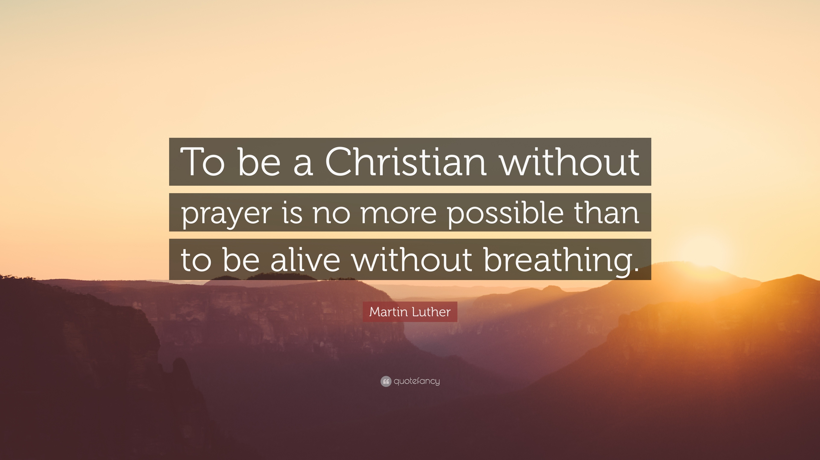

Slide 28
Let us pray!

